Slide 1
OOP Using java
Module 1:
The History and Evolution of Java
An overview of java
Data Types, Variables, and Arrays
Operators

Slide 2
The History and Evolution of Java
Java and its applications
Byte code
Java Development Kit (JDK)
Java Buzzwords
Java Virtual Machine (JVM)
The evolution of Java.

Slide 3
Java and its applications
Java is a general-purpose programming language that is class-based and object-oriented.
It is structured in such a way that developers can write code anywhere and run it anywhere without worrying about the underlying computer architecture. It is also referred to as write once, run anywhere (WORA).
Java is used for:
GUI applications
Web servers and applications servers
Middleware applications
Web applications
Mobile applications
Embedded systems
Enterprise applications

Slide 4
Java’s magic: the bytecode
Bytecode is a highly optimized set of instructions designed to be executed by the Java run-time system, which is called the Java Virtual Machine (JVM).
The original JVM was designed as an interpreter for bytecode.
Translating a Java program into bytecode makes it much easier to run a program in a wide variety of environments because only the JVM needs to be implemented for each platform.
Although the details of the JVM will differ from platform to platform, all understand the same Java bytecode.
JIT compiler, part of the JVM. Will compile selected portions of bytecode into executable code in real time, on a piece-by-piece, demand basis.

Slide 5
Java Development Kit (JDK)
The Java Development Kit (JDK) is a software development environment used for developing Java applications and applets.
It includes the Java Runtime Environment (JRE), an interpreter/loader (java), a compiler (javac), an archiver (jar), a documentation generator (javadoc) and other tools needed in Java development.
To run Java applications and applets, simply download the JRE.
To develop Java applications and applets as well as run them, the JDK is needed.
Java developers are initially presented with two JDK tools, java and javac. Both are run from the command prompt.
The javac compiler is invoked to create .class files. Once the .class files are created, the 'java' command can be used to run the java program.
Notes:
JDK and JRE
J2EE and J2ME

Slide 6
The Java features(Buzzwords)
• Simple
Easy to learn as it uses syntax similar to C/C++.
• Secure
• Portable: Write Once, Run Anywhere
• Object-oriented:
“everything is an object”,primitive types, such as integers, are kept as high performance non objects.

Slide 7
The Java features(Buzzwords)
• Robust
Memory Management :Garbage collector
Mishandled exceptions: Exception Handling
• Multithreaded
Parallel Computing for interactive systems
• Architecture-neutral
longevity(to withstand changes in operating systems) and portability
• Interpreted and High performance
• Distributed
Remote Method Invocation (RMI). This feature enables a program to invoke methods across a network
• Dynamic
run-time type information.

Slide 8
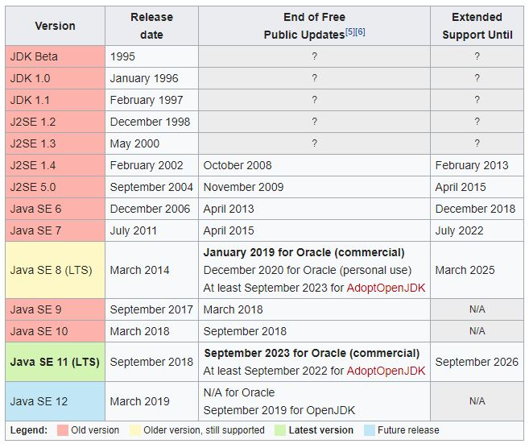
Java evolution

Slide 9
Object oriented programming
Two Paradigms
Process oriented
Object oriented
Abstraction: To hide the implementation.
Hierarchical abstractions.
The Three OOP Principles
Encapsulation: is the mechanism that binds together code and the data it manipulates, and keeps both safe from outside interference and misuse.
Access to the code and data inside the wrapper is tightly controlled through a well-defined interface.
a class is a logical construct; an object has physical reality.
Access specifiers are used to achieve encapsulation.
Inheritance: Inheritance is the process by which one object acquires the properties of another object.
it supports the concept of hierarchical classification.

Slide 10
Object oriented programming
Polymorphism: Polymorphism (from Greek, meaning “many forms”) is a feature that allows one interface to be used for a general class of actions.
Polymorphism, Encapsulation, and Inheritance Work Together:

Slide 11
First Java program, Edit-Compile-Run cycle, Java environment
To compile or run java program, JDK need to be installed and configured with environment variable.
A java program can be written on any text editor and the files should have java extension.
For Compilation: javac filename.java
For Executing: java classname
Ref: https://youtu.be/vhBNV8no4CI

Slide 12
Control statements
if
if else
Nested if
else if ladder
switch
break is optional in switch
Nested switch

Slide 13
Iteration statements
while
do while
for
for as foreach.
for-each is essentially read only.
Nested Loops

Slide 14

Lexical issues
Java programs are a collection of whitespace, identifiers, literals, comments, operators, separators, and keywords.
Whitespaces
Java is a free-form language, means that you do not need to follow any special indentation rules.
In Java, white space includes a space, tab, newline.
Identifiers
Identifiers are used to name things, such as classes, variables, and methods.
Java is case-sensitive, so VALUE is a different identifier than Value.
Valid Identifiers:
Invalid Identifiers

Slide 15
Lexical issues (Contd..)
Literals
A constant value in Java is created by using a literal representation of it.
Comments
Single Line: //
Multiline: /* Comment */
Documentation: /** Statements */
Allow you to embed information about your program into the program itself.
You can then use the Javadoc utility program (supplied with the JDK) to extract the information and put it into an HTML file.

Slide 16
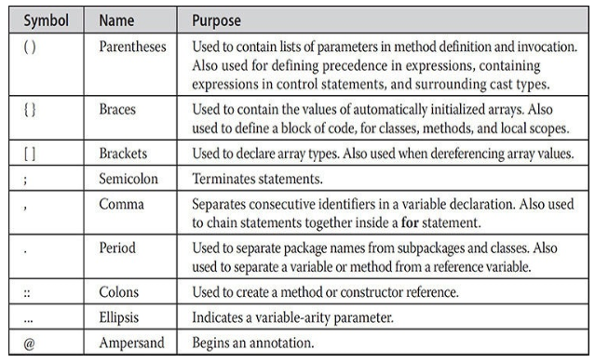
Lexical issues (Contd..)
Separators
The most commonly used separator in Java is the semicolon, it is often Used to terminate statements.

Slide 17
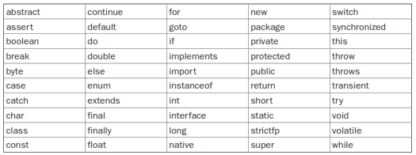
Lexical issues (Contd..)
Keywords
Note: These keywords cannot be used as names for a variable, class, or method.

Slide 18
identifiers in java
Identifiers are used for class names, method names, and variable names.
An identifier may be any descriptive sequence of uppercase and lowercase letters, numbers, or the underscore and dollar-sign characters.
They must not begin with a number, lest they be confused with a numeric literal.
Java is case-sensitive, so VALUE is a different identifier than Value.
Valid Identifiers Ex
Invalid Identifiers Ex
Notes:
These keywords cannot be used as names for a variable, class, or method.

Slide 19
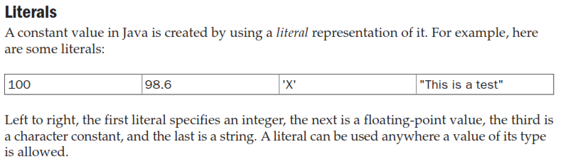

Slide 20
A closer look at literals
Integer Literals
Any whole number is an integer Literal, Ex: 1,2,3,42 etc….
There are two other bases which can be used in integer literals, octal (base eight) and hexadecimal (base 16).
Octal values are preceded with 0. 0-7 is octal range.
Hexadecimal values preceded with 0x or 0X. The range of a hexadecimal digit is 0 to 15, so A through F (or a through f ) are substituted for 10 through 15.
An integer literal can always be assigned to a long variable.
However, to specify a long literal, you will need to explicitly tell the compiler that the literal value is of type long. This is done by appending an upper- or lowercase L to the literal.
For example, 0x7ffffffffffffffL or 9223372036854775807L is the largest long.
An integer can also be assigned to a char as long as it is within range.
Notes:
Integers are numbers with base 10.

Slide 21
A closer look at literals(contd..)
Floating Point Literals
Floating-point numbers represent decimal values with a fractional component.
can be expressed in either standard or scientific notation.
Standard notation consists of a whole number component followed by a decimal point followed by a fractional component. For example, 2.0, 3.14159, and 0.6667.
Scientific notation uses a standard-notation, floating-point number plus a suffix that specifies a power of 10 by which the number is to be multiplied.
The exponent is indicated by an E or e followed by a decimal number, which can be positive or negative. Examples include 6.022E23, 314159E–05, and 2e+100.
Floating-point literals in Java default to double precision.
To specify a float literal, you must append an F or f to the constant.
You can also explicitly specify a double literal by appending a D or d.
The default double type consumes 64 bits of storage, while the less-accurate float type requires only 32 bits.

Slide 22
A closer look at literals(contd..)
Boolean Literals
There are only two logical values that a boolean value can have, true and false.
The values of true and false do not convert into any numerical representation.
The true literal in Java does not equal 1, nor does the false literal equal 0.
In Java, they can only be assigned to variables declared as boolean, or used in expressions with Boolean operators.

Slide 23
A closer look at literals(contd..)
Charecter Literals
They are 16-bit values that can be converted into integers and manipulated with the integer operators, such as the addition and subtraction operators.
A literal character is represented inside a pair of single quotes.
All of the visible ASCII characters can be directly entered inside the quotes, such as ‘a’, ‘z’, and ‘@’.
For characters that are impossible to enter directly, there are several escape sequences that allow you to enter the character you need, such as ‘\’’ for the single-quote character itself and ‘\n’ for the newline character.
There is also a mechanism for directly entering the value of a character in octal or hexadecimal. For octal notation, use the backslash followed by the three-digit number. For example, ‘\141’ is the letter ‘a’.
For hexadecimal, you enter a backslash-u (\u), then exactly four hexadecimal digits. For example, ‘\u0061’ is the ISO-Latin-1 ‘a’ and ‘\ua432’ is a Japanese Katakana character.

Slide 24
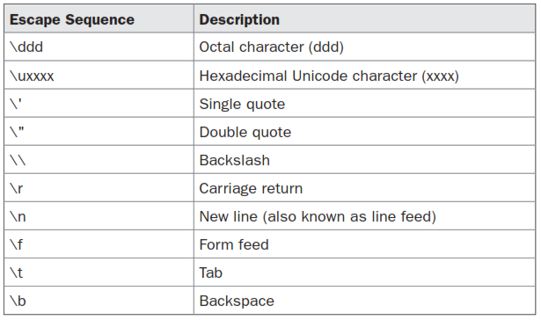
A closer look at literals(contd..)
Character Escape Sequences

Slide 25
A closer look at literals(contd..)
String Literal
String literals in Java are specified like they are in most other languages—by enclosing a sequence of characters between a pair of double quotes. Examples of string literals are
“Hello World”
“two\nlines”
“\”This is in quotes\”“
The escape sequences and octal/hexadecimal notations that were defined for character literals work the same way inside of string literals.
Strings must begin and end on the same line. There is no line-continuation escape sequence.

Slide 26
Data types, variables and arrays
Java Is a Strongly Typed Language
First, every variable has a type, every expression has a type, and every type is strictly defined.
Second, all assignments, whether explicit or via parameter passing in method calls, are checked for type compatibility.
The Java compiler checks all expressions and parameters to ensure that the types are compatible.
Any type mismatches or errors that must be corrected, will be done before the compiler will finish compiling the class.

Slide 27
The Primitive Types
Integers: This group includes byte, short, int, and long, which are for whole-valued signed numbers.
Floating-point numbers: This group includes float and double, which represent numbers with fractional precision.
Characters: This group includes char, which represents symbols in a character set, like letters and numbers.
Boolean: This group includes boolean, which is a special type for representing true/false values.

Slide 28
The Primitive Types
Byte
The smallest integer type is byte. This is a signed 8-bit type that has a range from –128 to 127.
Especially useful when you’re working with a stream of data from a network or file.
also useful when you’re working with raw binary data that may not be directly compatible with Java’s other built-in types.
Ex: byte b,c;
short
short is a signed 16-bit type. It has a range from –32,768 to 32,767.
It is probably the least-used Java type.
Ex: short s,t;

Slide 29
The Primitive Types
Int
The most commonly used integer type is int.
It is a signed 32-bit type that has a range from –2,147,483,648 to 2,147,483,647.
variables of type int are commonly employed to control loops and to index arrays.
long
long is a signed 64-bit type and is useful for those occasions where an int type is not large enough to hold the desired value.
The range of a long is quite large. This makes it useful when big, whole numbers are needed.
Notes:
Although you might think that using a byte or short would be more efficient than using an int in situations in which the larger range of an int is not needed, this may not be the case. The reason is that when byte and short values are used in an expression they are promoted to int when the expression is evaluated.

Slide 30
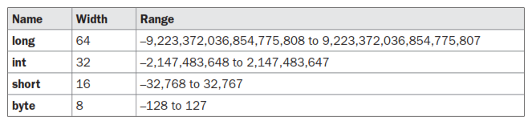
The Primitive Types

Slide 31
The Primitive Types
Float
The type float specifies a single-precision value that uses 32 bits of storage.
Single precision is faster on some processors and takes half as much space as double precision, but will become imprecise when the values are either very large or very small.
Variables of type float are useful when you need a fractional component, but don’t require a large degree of precision.
Ex: float hightemp,lowtemp;
Double
Double precision, as denoted by the double keyword, uses 64 bits to store a value.
Double precision is actually faster than single precision.
some modern processors that have been optimized for high-speed mathematical calculations.
All transcendental math functions, such as sin( ), cos( ), and sqrt( ), return double values.
Notes:
Single Precision: +2.5
Sign:1-bit
Exponent: 8-bits
Fraction: 23bits
Double Precision: 1+11+52

Slide 32
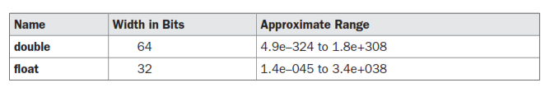
The Primitive Types
Char
used to store characters is char.
Java char is a 16-bit type.
The range of a char is 0 to 65,536.
There are no negative chars.
The standard set of characters known as ASCII still ranges from 0 to 127 as always, and the extended 8-bit character set, ISO-Latin-1, ranges from 0 to 255.

Slide 33
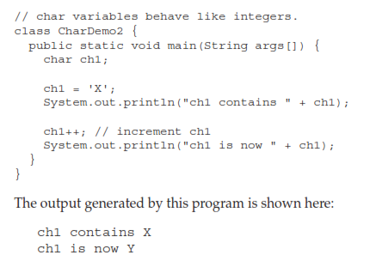
The Primitive Types
Char

Slide 34
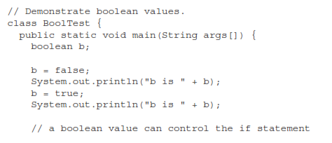
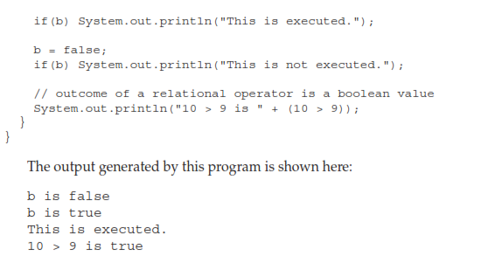
The Primitive Types
Booleans
It can have only one of two possible values, true or false.
This is the type returned by all relational operators, as in the case of a < b. boolean is also the type required by the conditional expressions that govern the control statements such as if and for.

Slide 35
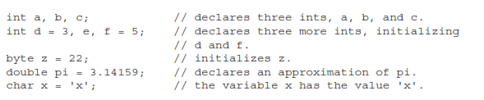
variables
The variable is the basic unit of storage in a Java program.
A variable is defined by the combination of an identifier, a type, and an optional initializer.
Syntax:
Data_type identifier [= value] ;

Slide 36
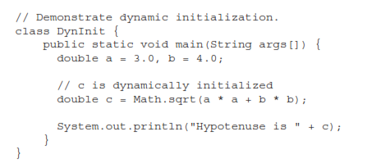
variables
Dynamic Initialization

Slide 37
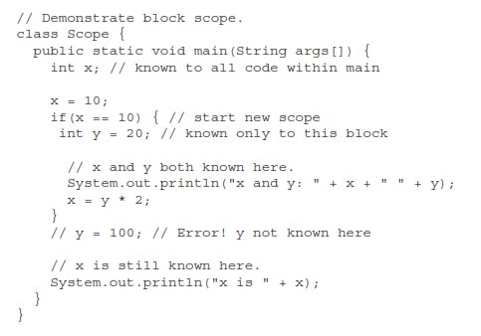
variables
Scope and Lifetime of Variables
A block defines a scope. Thus, each time you start a new block, you are creating a new scope.
A scope determines what objects are visible to other parts of your program. It also determines the lifetime of those objects.

Slide 38
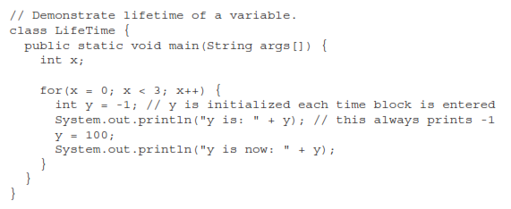
variables
variables are created when their scope is entered, and destroyed when their scope is left.

Slide 39
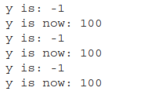
variables

Slide 40
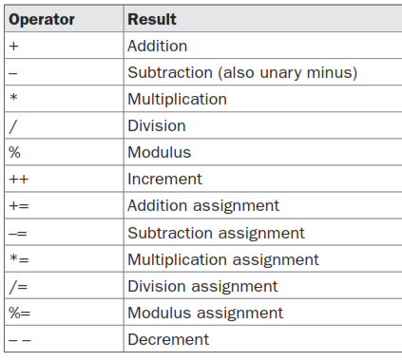
operators
Arithmetic Operators
The operands of the arithmetic operators must be of a numeric type.
You cannot use them on boolean types, but you can use them on char types, since the char type in Java is essentially, a subset of int.

Slide 41
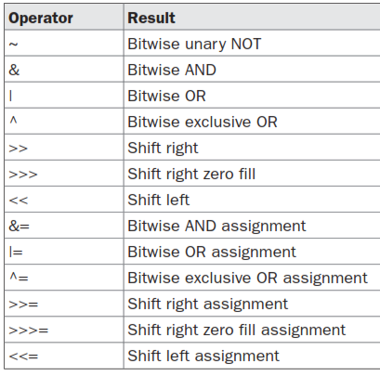
Operators(Contd..)
The Bitwise Operators
Java defines several bitwise operators that can be applied to the integer types, long, int, short, char, and byte. These operators act upon the individual bits of their operands.
Notes:
>>: Preserves sign bit, will work same for negative numbers also.
>>>:Doesn’t Preserve the sign bit, with negative numbers the behaviour will vary.
Note: in java Negative numbers are stored as 2’s Complement values.

Slide 42
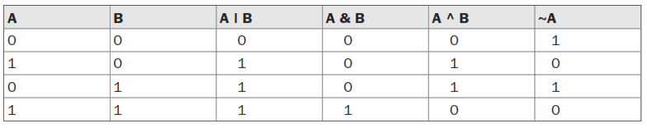






Operators(Contd..)
Bitwise Logical Operators

Slide 43
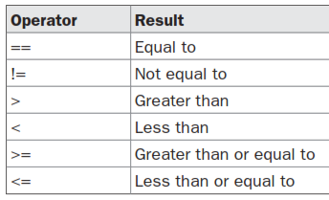
Operators(Contd..)
Relational Operators

Slide 44
Operators(Contd..)
The ? Operator
Java includes ternary (three-way) operator that can replace certain types of if-then-else statements. This operator is the ?.
The ? has this general form:
comdition1 ? expressionifconditionistrue : expressionifconditionisfalse
Here, expression1 can be any expression that evaluates to a boolean value. If expression1 is true, then expression2 is evaluated; otherwise, expression3 is evaluated.
The result of the ? operation is based on the expression1 evaluation.
Both expression2 and expression3 are required.

Slide 45
Type conversion and casting
When one type of data is assigned to another type of variable, an automatic type conversion will take place if the following two conditions are met:
The two types are compatible.
The destination type is larger than the source type.
There are no automatic conversions from the numeric types to char or boolean. Also, char and boolean are not compatible with each other.
Implicit type conversions can be called as widening conversions.
Explicit type conversion may result in losing the data, so it can be called as narrowing conversion.
Syntax: (target-type) value;
If the integer’s value is larger than the range of a byte, it will be reduced modulo (the remainder of an integer division by the byte’s range).
when a floating-point value is assigned to an integer type truncation will occur.

Slide 46

Type conversion and casting
Automatic Type Promotion in Expressions
In an expression, the precision required of an intermediate value will sometimes exceed the range of either operand.
The result of the intermediate term a*b easily exceeds the range of either of its byte operands.
Java automatically promotes each byte, short, or char operand to int when evaluating an expression.
This means that the subexpression a*b is performed using integers—not bytes. Thus, 2,000, the result of the intermediate expression, 50 * 40, is legal even though a and b are both specified as type byte.
Notes:
byte b = 50;
b = b * 2; // Error! Cannot assign an int to a byte!
Solution:
byte b = 50;
b = (byte)(b * 2);
Analyse 2:
class Promote{
public static void main(String args[]) {
byte a=127;
byte b=1;
byte result=(byte)((a*b)+1);
System.out.println("result = " + result);
}
}

Slide 47
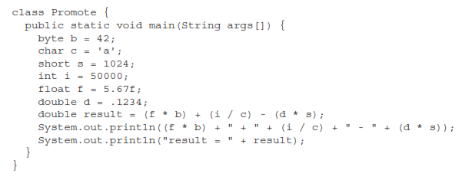
Type conversion and casting
The Type Promotion Rules
All byte, short, and char values are promoted to int.
Then, if one operand is a long, the whole expression is promoted to long.
If one operand is a float, the entire expression is promoted to float.
If any of the operands is double, the result is double.
Notes:
Analyse: double result = (f * b) + (i / c) - (d * s);
f * b, b is promoted to a float
i/c promoted to int
d*s promoted to double
Finally, operation on int, float and double is considered result will be promoted to double.

Slide 48
Control statements
if
if else
Nested if
else if ladder
switch
break is optional in switch
Nested switch

Slide 49
Iteration statements
while
do while
for
for as foreach.
for-each is essentially read only.
Nested Loops

Slide 50
arrays
An array is a group of like-typed variables that are referred to by a common name.
Arrays of any type can be created and may have one or more dimensions.
A specific element in an array is accessed by its index.
Arrays offer a convenient means of grouping related information.
One-Dimensional Arrays
The general form of a one-dimensional array declaration is
type var-name[ ];
Here, type declares the base type of the array.
Ex: int month_days[];
This declaration establishes the fact that month_days is an array variable,
No array actually exists.
To link month_days with an actual, physical array of integers, you must allocate one using new and assign it to month_days.

Slide 51
arrays
The general form of new as it applies to one-dimensional arrays appears as follows:
array-var = new type[size];
to use new to allocate an array, you must specify the type and number of elements to allocate.
The elements in the array allocated by new will automatically be initialized to zero.
So, Arrays will be created in two steps, First array variable is created, then it will be physically created by using new keyword.
int month_days[];
Month_days=new int[12];

Slide 52
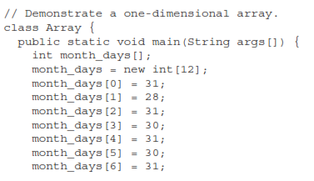
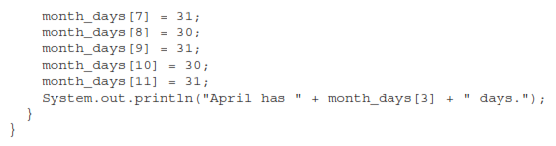
arrays
Once you have allocated an array, you can access a specific element in the array by specifying its index within square brackets.
All array indexes start at zero.

Slide 53
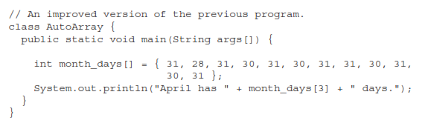
arrays

Slide 54
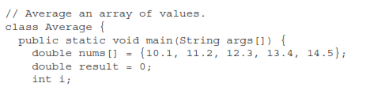
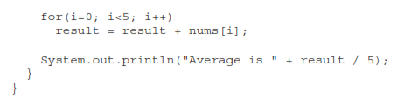
arrays

Slide 55
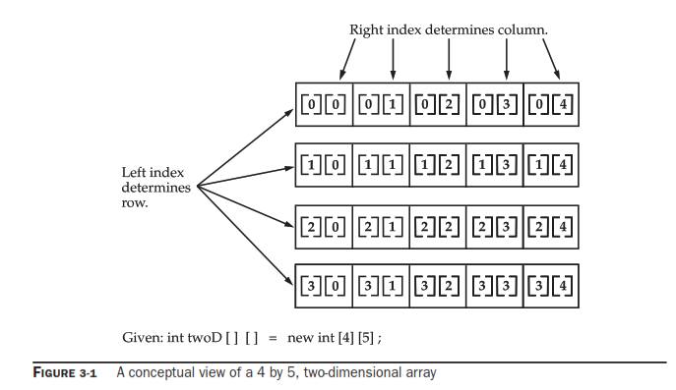
Multidimensional arrays
In Java, multidimensional arrays are actually arrays of arrays.
To declare a multidimensional array variable, specify each additional index using another set of square brackets.
Ex: int twoD[][]=new int[4][5];

Slide 56
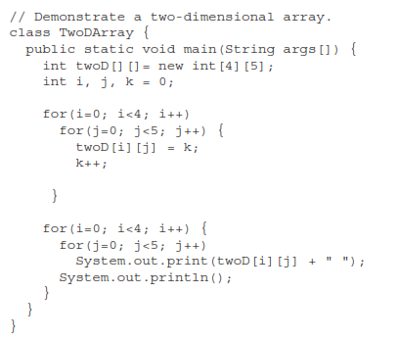
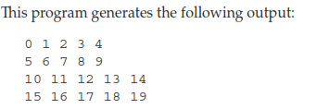
Multidimensional arrays

Slide 57
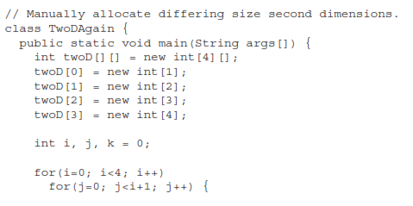
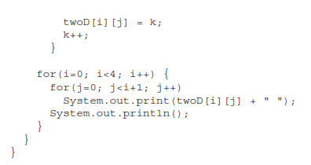
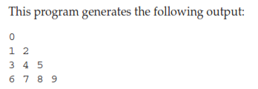
Multidimensional arrays

Slide 58
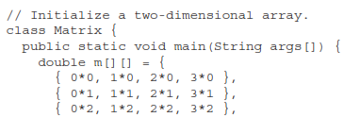
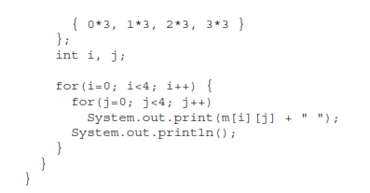

Multidimensional arrays

Slide 59
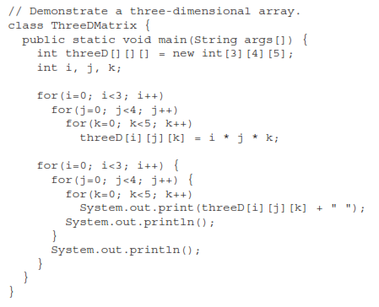
Multidimensional arrays

Slide 60
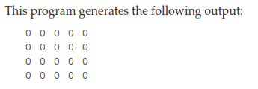
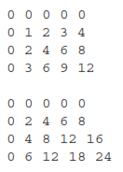
Multidimensional arrays

Slide 61
Alternative Array Declaration Syntax
There is a second form that may be used to declare an array is:
type[ ] var-name;
int al[] = new int[3];
int[] a2 = new int[3];
The following declarations are also equivalent:
char twod1[][] = new char[3][4];
char[][] twod2 = new char[3][4];
int[] nums, nums2, nums3; // create three arrays.
int nums[], nums2[], nums3[]; // create three arrays.

